Slide 1
Microsoft Office and web
Proud by :
Wael Chrif
Nasime Abbad
Mohamed Elamine Abbaci
Houssem eddine zerrout
Grp 1

Slide 2





Content of the presentation :
Topics | Category 1
Topic one : Microsoft Office | Chapter 1 : introduction to Microsoft Office
 | Chapter 2 : Microsoft Word
 | Chapter 3 : Microsoft Excel
 | Chapter 4 : Microsoft PowerPoint
Topic two : web | Chapter 1: introduction to web
 | Chapter 2 : World Wide Web (HTML , CSS)
 | Chapter 3 : Google services
 | Chapter 4 : version control tools (Git and GitHub)

Slide 3

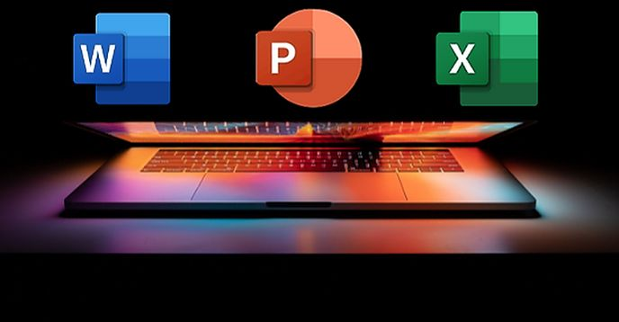
Introduction to Microsoft office
Microsoft Office is a popular suite of productivity applications developed by Microsoft. It includes several software programs, such as:
-WORD
-EXCEL
-POWER POINT

Slide 4

01
CHAPTER 1 :
Microsoft word

Slide 5
Microsoft word
Microsoft Word is a widely used word processing program developed by Microsoft. It allows users to create, edit, and format text-based documents with various formatting options. Word also offers customizable appearance tools, allowing multiple users to work on the same document simultaneously. It provides pre-designed templates for various types of documents, integrates with other Office applications like Excel and PowerPoint, and allows users to publish their documents in various formats, including PDF, HTML, and web pages. It also allows users to share documents via email, cloud storage services, or collaboration features like SharePoint or OneDrive.

Slide 6
02
CHAPTER 2 :
Microsoft Excel

Slide 7
Microsoft Excel
Microsoft Excel is a spreadsheet program developed by Microsoft, used for data analysis, organization, and calculation. It offers a grid-like interface for creating and formatting spreadsheets, built-in formulas and functions for calculations, data sorting and filtering tools, data visualization through charts, graphs, and pivot tables, data analysis tools like data validation, conditional formatting, and goal seeking, and seamless integration with other Office applications like Word and PowerPoint. Excel is a powerful tool for data analysis, financial modeling, project management, and other activities that require efficient data manipulation and organization. It supports multiple users working on the same spreadsheet simultaneously and allows for seamless integration with other Office applications

Slide 8
03
CHAPTER 3 :
Microsoft Power point

Slide 9
Microsoft Power point
Microsoft PowerPoint is a versatile presentation software that allows users to create visually appealing slideshows using text, images, videos, and other multimedia elements. Key features include customizable slide templates, animation and transition effects, collaboration and sharing, a presenter view with advanced tools, and various slide show options. PowerPoint is part of the Microsoft Office suite and is widely used in businesses, educational institutions, and professional settings. It is available on both Windows and Mac operating systems.

Slide 10
Topic1 conclusion
These three applications are considered the core components of Microsoft Office and are widely used in both professional and personal settings. They are available for both Windows and macOS operating systems and offer extensive features and tools to enhance productivity and facilitate document creation, data analysis, and presentation delivery.

Slide 11

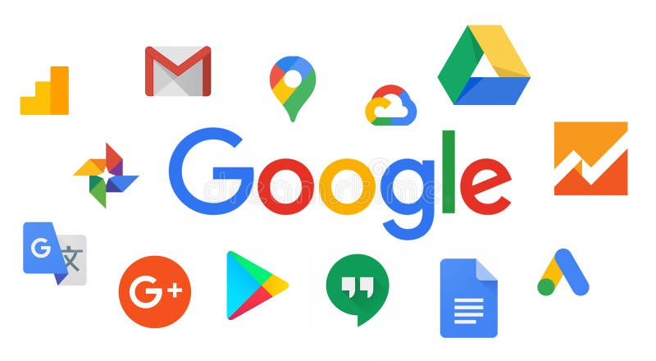
Introduction to WEB
The World Wide Web, invented by Tim Berners-Lee in 1989, is a decentralized network of interlinked documents and resources accessible through the internet. It operates on a client-server model, with web pages created using HTML, CSS, and JavaScript. The Web has revolutionized global communication, information sharing, and led to new industries like e-commerce, online advertising, and social networking, with its impact on society and the economy continuing to grow.

Slide 12
01
CHAPTER 1 :
HTML , CSS

Slide 13
HTML , CSS
HTML (Hypertext Markup Language)
CSS (Cascading Style Sheets)
CSS is a style sheet language used to describe the visual presentation of a web page.
CSS controls the visual appearance of HTML elements, including layout, colours, fonts, and animate
CSS uses selectors to target HTML elements and apply styles. Ions.
CSS is focused on presentation and aesthetics, enhancing the visual appearance of web pages.
HTML is a markup language used to structure the content of a web page.
HTML provides the basic structure and elements of a web page, such as headings, paragraphs, images, and links
HTML uses tags to define the structure of a web page
HTML is focused on content and semantics, providing meaning to the structure of web pages.

Slide 14
02
CHAPTER 2 :
Google services

Slide 15
Google services
Google services encompass a range of products and applications offered by Google, including Google Play services, which provide core functionalities like authentication, privacy settings, and location-based services for other Google apps. Users can also create a Google Account to access various Google services and customize their experience.
To create a Google Account, users must visit the Google Account creation page, fill out required information, agree to terms and policies, complete the Captcha, and verify their phone number. After completing the account setup, users can set up preferences such as language, location, and privacy settings. Google also offers a wide range of products and services, including Android, Chrome OS, YouTube, Google Maps, Google Docs, Google Drive, and Google Photos, catering to various needs. Google also provides subscriptions and services like Nest Aware, Google Fi Wireless, cloud storage, gaming, and more. These services help users with various aspects of their daily lives, from communication and productivity to entertainment and storage

Slide 16
Some information about popular Google services
Gmail
Send and receive emails, manage contacts and organize mail
Google Drive
Store and share files, collaborate on documents and folders
Google Docs
Create, edit, and collaborate on text documents
Google Sheets
Create, edit, and analyse spreadsheet data
Google Slides
Create, edit, and deliver presentations

Slide 17
03
CHAPTER 3 :
Git and GitHub

Slide 18
Git and GitHub
Git and GitHub are essential tools in web development, providing version control and collaboration tools. Git allows developers to track changes and manage different versions of their code, enabling multiple developers to work on the same project simultaneously. GitHub, a web-based hosting service, stores, manages, and collaborates on Git repositories, offering a convenient web interface for easy access and management. These tools enhance productivity and facilitate efficient teamwork among developers, allowing them to track changes, manage code versions, and collaborate on web-based projects

Slide 19
Some statistic about Git,GitHub

Slide 20
Thanks!

